Slide 1
McDonald’s in Seoul: Food Choices, Identity and Nationalism

Slide 2
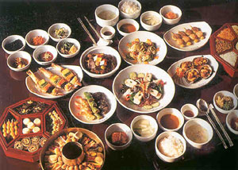
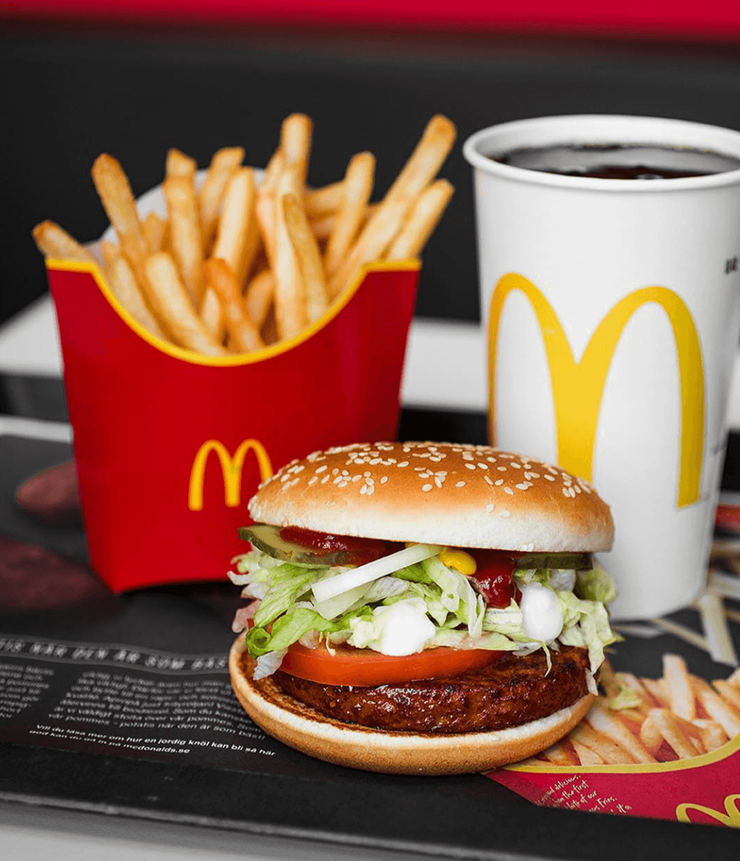
http://www.asianinfo.org/asianinfo/korea/pictures/koreanfood.jpg accessed 10.03.19
https://livekindlyproduction-8u6efaq1lwo6x9a.stackpathdns.com/wp-content/uploads/2018/02/mcvegan-meal.png accessed 10.03.19

Slide 3
Korean dilemma – people wish to be simultaneously nationalistic and global
1992 - Ministry of Agriculture, Forestry, and Fishing and National Agricultural Cooperative Federation (NACF) jointly produced a poster to promote the consumption of local agricultural produce
"Healthy eating = Eating our Rice,"
Rice and hamburgers are clearly understood symbols representing indigenous Korean food versus imported American food

Slide 4
Increase in demand for McDonald’s food
People wanted to sample western food
Convenient
Variables like gender, economic conditions and political viewpoint – dramatic effects on attitude towards American fast food
Ex- Dramatic generational differences: it may be hard to convince a Korean child, whose favourite venue for birthday parties is McDonald's, that hamburgers are not part of her indigenous food culture.
Arjun Appadurai (Indian-American Anthropologists) - in every society certain objects or commodities carry powerfully loaded social messages
Ex- Cloth (woven by charkha) did in the context of Gandhi's resistance to British imperialism in pre-1947 India

Slide 5
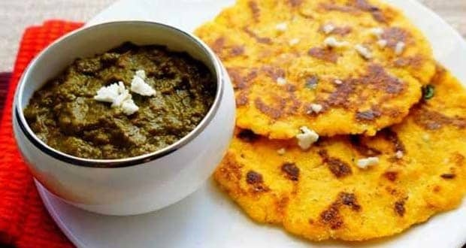
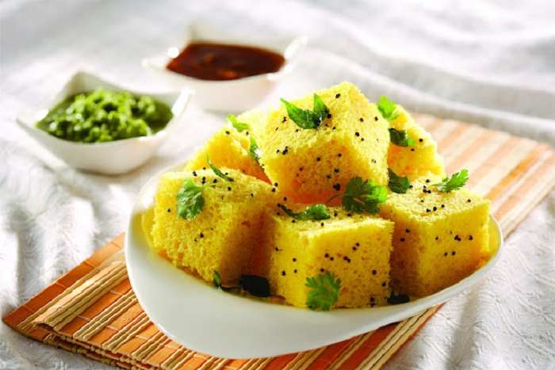
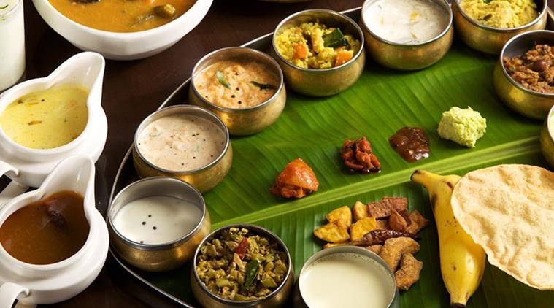
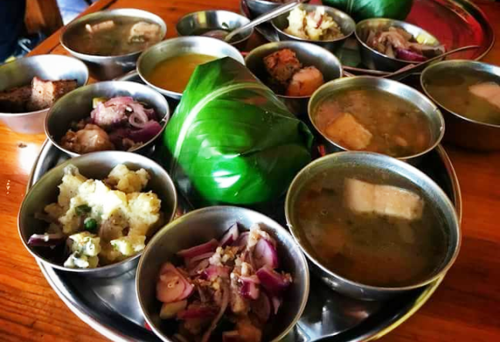
https://qph.fs.quoracdn.net/main-qimg-85cc0e35d9ea3482c6745facb0752b14 accessed 10.03.19
https://www.culturalindia.net/iliimages/Gujarati-Food-ili-87-img-1.jpg accessed 10.03.19
https://kaziranganationalparkassam.files.wordpress.com/2018/09/screenshot_2018-08-08-18-52-07-843_com-facebook-katana.png?w=648 accessed 10.03.19
https://images.indianexpress.com/2018/08/onam-sadhya-759.jpg accessed 10.03.19

Slide 6
Foods, especially staple foods, often become intertwined with a group's identity
Appadurai argues that those items most saturated with social messages (e.g., cloth or rice) are "likely to be least responsive to crude shifts in supply or demand, but most responsive to political manipulation”
As rice symbolizes Korean indigenousness, so McDonald's hamburgers carry the burden of symbolizing Americana-regarded with deep ambivalence by many Koreans.

Slide 7
"The tyranny of American fast food companies in the Korean market"
"McDonald's joint venture scheme”
McDonald's as a “Local" Institution
Korean business – 50% share
McDonald's is Korean is an interesting argument when one considers the company's ongoing efforts to represent its products as authentically American, and hence different from the hamburgers sold at local, supposedly less prestigious, restaurants
Business in Korea is conducted exclusively by Koreans – complex banking system
Employees considered McDonald's a model company, one that donates money to local charitable causes and reinvests a substantial proportion of its profits in Korea
Women – satisfied with the company's openness and relative lack of hierarchy, which in their view led to greater gender equality than is normally the case in Korean business circles

Slide 8
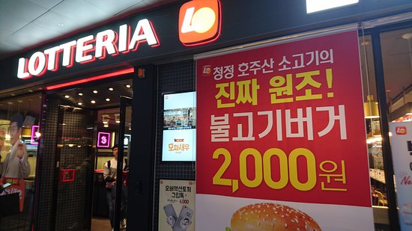
McDonald's and Its Rivals
Lotteria, a restaurant chain that opened in Korea (1979) prior to McDonald's, initially claimed that it sold authentic American hamburgers made from pure beef
https://media-cdn.tripadvisor.com/media/photo-s/13/f5/59/f8/caption.jpg accessed 10.03.19

Slide 9
McDonald's and Its Rivals
Lotteria's employees spoke basic English when transmitting orders among themselves – for gaining the authenticity
After the introduction of McDonald's and other American chains - Lotteria began to represent itself as a purveyor of delicious hamburgers, catering to specifically Korean tastes - pulgogi burgers (Korean-style barbecued beef and teriyaki burgers a Japanese style marinated and grilled beef which sold well
Lotteria employees stopped speaking English among themselves and stopped talking about their "American" hamburgers

Slide 10
Creating a Market for McDonald's
Hamburgers were more readily categorized by their bread (ppang), than by their meat (kogi).
To change this perception, the "value meal" was introduced: McDonald's offered a 10 percent discount on four combinations that included a burger, french fries, and a soft drink. The intention behind this campaign was to attract customers who would eat an entire set of foods and, in so doing, realize that hamburgers can form the basis of a filling meal
Local managers were making their first plans to augment the menu with items designed to appeal to Korean tastes, such as melon-flavored milk shakes

Slide 11
Negotiating Gender
Eating a hamburger in what is perceived primarily as a children's place is not appealing to most grown men.
The food-ordering process at fast food restaurants, where people have to order and pay for the food before they sit down and eat it, makes some Korean men feel uncomfortable.
In traditional restaurants, customers pay after the meal is eaten, which usually results in everyone's competing to pay for the whole table. Some men told me that they feel awkward and stingy paying for just their own food

Slide 12
Negotiating Gender
Even before the introduction of fast food, women generally felt more comfortable about dividing up the check
Another reason women like McDonald's is that, like most fast food chains and unlike most conventional restaurants, it does not serve alcoholic beverages
An alcohol-free and child-friendly environment is perceived as an appropriate and safe place for women unaccompanied by male family members or friends

Slide 13
Negotiating Space
Given the high rent in urban Korea, and the fact that most McDonald's restaurants are located in central commercial districts, full profitability is only possible when restaurants are packed with paying customers who do not linger, thereby making possible a high turnover rate
Korean consumers on the whole, however, treat "fast" food restaurants as leisure centers and tend to stay longer than do most Americans
When one considers that American McDonald's restaurants do a significant amount of business at their drive-through windows, an option that is not feasible at most Korean outlets, one can understand the management's concern for controlling eating time at the Seoul restaurants

Slide 14
Negotiating Space
To alleviate the space problem McDonald's has introduced hostessing: women employees circulate to assist customers and put subtle pressure on people to leave when they have finished
People who do not buy food from the restaurant and use the space for other purposes are also made uncomfortable
Korean customers find it less awkward to be conducted to a seat by an employee than to ask a stranger for permission to share a table
In their desire for a speedy turnover, employees will go so far as to clean off the tables where customers are still seated
Neighborhood where the restaurant is located. In more affluent areas, where the traffic is relatively light, staff intrusion is less evident.

Slide 15
Negotiating Space
Young people (especially women college students and dating couples) often convert McDonald's restaurants into cafes where they chat over coffee or soft drinks
The restaurants are a more economical choice than cafes or coffeehouses because they offer clean, comfortable, and air-conditioned spaces
The courteous service, which is somewhat unusual by Korean standards for a moderately priced restaurant, is another reason why young people feel comfortable at McDonald's
Moving birthday celebrations from the child's home to a public place has also changed the form of the parties, and children now expect to celebrate with their friends rather than family members, a break from accepted tradition

Slide 16
Negotiating Space
McDonald's provides party paraphernalia (such as paper crowns) and complimentary gifts that children take home in plastic bags.
Ex- In the summer of 1994, when the weather was unusually hot, the gifts were paper fans shaped and printed like Big Macs.
Without question, these gifts are very effective in making other children want to have their birthday parties at McDonald's
There is thus a constant negotiation between management and customers on the one hand, and between various groups of customers on the other, regarding the definition and use of restaurant space.
McDonald's has tried hard to politely "educate" its consumers in the rules of fast food restaurants not only is the service fast, but customers are expected to eat fast and leave fast, too

Slide 17
Negotiating Space
Customers were willing to pay higher prices at McDonald's instead of eating at a locally owned fast food restaurant because they preferred a clean, air-conditioned environment.
For this reason, take-out is not an attractive option. Korean consumers have the clear idea that they are paying for space, and they wish to enjoy themselves in a pleasant environment
Many people who use McDonald's restaurants as meeting places purchase only ,'drinks, or buy nothing at all, going elsewhere as soon as they have met their friends.
Those who decide to eat in the restaurant tend to wait for the other parties to arrive before purchasing anything. These local customs aggravate the problem of crowding, but the management seems to have accepted this as the price of their restaurants' popularity.

Slide 18
Negotiating Space
Another group of people who frequent the restaurants but do not purchase food are those who enter simply to use the rest rooms. Given the lack of public toilets in Korea, the relatively clean and convenient facilities provided by McDonald's encourage heavy traffic. Although the management does not explicitly discourage casual visitors from using their rest rooms, most restaurants display signs saying, "Please order before going upstairs" (where the toilets and most of the tables are usually located

Slide 19
Consumption, Resistance, and Foreign Imports
Many people seemed concerned that the Korean economy would be adversely affected if they patronized foreign-based restaurant chains
Preference for foreign goods is a sign of conspicuous consumption and vanity
Newspaper and television journalists keep close track of multinational corporations, including fast food chains. Most of the coverage by the mass media has been negative. Price gouging and profiteering, low nutritional and sanitary standards, and social irresponsibility are often cited as the main reasons to avoid foreign foods

Slide 20
Consumption, Resistance, and Foreign Imports
"Foreign franchise restaurants leave their lights on all night to draw attention to their restaurants despite the nationwide movement to save energy"
"Foreign fast foods are not hygienic, ... they use bacon and ham that already are past their expiration dates”
Yet another newspaper article claimed that, "Fast food is full of fecal bacilli. ... The Association of Housewives found as many as 100 million fecal bacilli in one gram of sandwich.

Slide 21
Consumption, Resistance, and Foreign Imports
American cultural imperialism-defined as the encroachment of cultural practices and values that reflect American political and economic power-is also frequently cited as a reason for Koreans to shun McDonald's restaurants
The management argued – preferring McDonalds should be taken as an economic decision on the part of an individual consumer rather than as symbolic behavior representing an overarching political ideology.
Emphasizing McDonald's good value and convenience as a family restaurant is in line with the company's overall marketing strategy in Korea

Slide 22
Consumption, Resistance, and Foreign Imports
Popular sympathy toward farmers and native rice is fostered by the Korean media, notably television documentaries dealing with agricultural issues. The intention behind these documentaries is clearly shown by their titles, such as: "American rice waiting for our doors to open”
The programs stress the higher quality of native rice and the need for Koreans to eat what is produced in their own country, for both the physical health of consumers and the economic health of the nation
The Korean mass media often frame the issue in terms of the survival of farmers, while downplaying the fact that Korean consumers would benefit from the lower price of imported rice. Despite this economic reality, urban industrial workers are often among the most active participants in anti-import campaigns, which are organized by farmers' associations and allied organizations

Slide 23
Commensality and Individualism in Korea's Culinary Culture
In Korean, as in Chinese and Japanese language the term for "meal” is the same as the term for "cooked rice”
Rice was associated with good life and was most popular source of carbohydrate
Korean folklore represents the affluent person as someone who lives in a tile-roofed house (shaped like a whale's back) while enjoying a steady diet of cooked rice and beef soup.
For example, the story of Hungbu, one known to all Koreans, is about an extremely poor yet virtuous man whose children craved snow-white cooked rice (as opposed to lowgrade brown rice) and meat broth
Rice is thus more than a simple grain; it is imbued with symbolic meanings and is perceived as sacred by many Koreans. Women are instructed not to waste a single grain lest they anger the gods and ruin the household's luck

Slide 24
Commensality and Individualism in Korea's Culinary Culture
In the 1970s the government implemented a number of aggressive policies to promote rice production, including a price support system as well as a research and development program
Once Korea achieved self-sufficiency in rice production, the government changed its emphasis to producing tastier rice
Eating rice in Korea promotes commensality. People share rice that has been cooked in the same pot and usually share side dishes, except during special banquets. Sharing a residence is often called "eating rice from the same cooking pot
In McDonald’s and other fast food restaurants, by contrast, customers pursue their own individualistic tastes. Although groups of people may eat together, they do not ordinarily share the food-except for french fries

Slide 25
Commensality and Individualism in Korea's Culinary Culture
In Korea, even when friends purchase separate packets of fries, they often pour the contents onto a tray and together eat from the resulting pile. This does not, however, create the same powerful sense of commensality as sharing a rice-based meal
One can eat alone in McDonald's and not feel strange; eating in isolation at a Korean-style restaurant, on the other hand, generates feelings of loneliness and self-pity
McDonald's food, in the study was found to facilitate personal choice and promote individuality, themes which appeal to the new generation, who regard uniqueness as an important quality
One reason why McDonald's has not been more readily accepted by adult Koreans is that the style of food does not fit easily into the existing Korean food system

Slide 26
Commensality and Individualism in Korea's Culinary Culture
Hamburgers, in particular, have not found a "niche" in the preexisting hierarchy of food. Other foreign products, such as instant coffee, Spam, processed cheese, and Coca-Cola, have not presented a direct threat to the rice-based, "proper" Korean meal. Rather, these items have been subsumed into recognizable food categories
Ex- Spam dishes are eaten with rice and other side dishes, thus fitting comfortably into traditional food categories
Hamburgers, by contrast, constitute an entirely new category. Spam has been thoroughly "localized" in Korea, whereas the Big Mac is still "foreign," not only as a trade-marked brand name but also as a category of food

Slide 27
Commensality and Individualism in Korea's Culinary Culture
Perhaps as a consequence of recent economic growth and the rising consumption level, McDonald's hamburgers are not considered haute cuisine by most Korean consumers. This has made it difficult for the company to find a niche in the local market
On the one hand, managers realize that it is important to portray McDonald's as the "authentic" American hamburger restaurant; on the other, attempts are under way to become "local" and thereby fit into the class of ordinary purveyors of everyday food
Conclusions
The article depicts about a series of negotiations and contestations regarding the meanings, demand for, and consumption of McDonald's hamburgers in Korea.

Slide 28
Difference in attitude among Koreans towards McDonald’s
Demand, in this case, is not a "natural" economic force, nor is it a constant and universal state
In Korea, the consumption of hamburgers communicates a variety of often contradictory messages. The farmers who promote the consumption of local produce argue that eating McDonald's hamburgers is tantamount to treason and the loss of Korean identity
Those who work for McDonald's convey the message that the consumption of hamburgers is a matter of rational choice, an ideologically neutral exercise based on personal tastes
The perceived seriousness of eating foreign-based foods is related to a general ambivalence toward achieving a globalized lifestyle and in the process losing one's identity as a Korean

Slide 29
Symbolic meaning of food
The fact that many children prefer foreign foods (pizza, hamburgers) to traditional dishes (kimchi, beef soup) is taken as a warning sign about the impending loss of Korean identity, since what is consumed is literally converted into the bodies of this next generation
In addition to the essential role food plays in the formation of the body, consuming foreign items also poses a threat to the social body
In Korean society, sharing food promotes solidarity not only among the living, but also between the ancestors and their descendants. The symbolic eating of food that first has been offered in ancestor worship ceremonies (umbok, or "partaking of luck") is a vivid example of how food connects various family members, both living and dead

Slide 30
Symbolic meaning of food
The items used in preparing food for different religious ceremonies must be familiar to the ancestors; their consumption, both spiritual and corporal, assures the continuity of Korean descent lines.
The contestations regarding the consumption of foreign foods must be understood, therefore, in the context of social practices that involve far more than personal taste
Korean consumers as a group and Koreans as individuals have been actively creating and redefining the transactional terms that condition acceptance of McDonald's hamburgers

Slide 31
Opinion of Korean people of McDonald’s food and marketing strategies
Korean Customers – They believe that their food choices do not simply reflect government guidelines or the agendas of interest groups that play on patriotic themes. Nor do they think that they are blindly influenced by the sophisticated marketing strategies of multinational restaurant chains
The young people who use the pleasant environment of McDonald's to socialize and study are fully aware that the management's intended use of this space is at odds with their own
Many customers even feel that they are taking advantage of the company by not spending enough money to compensate for the service received. Korean women have also found their own way to convert the space provided by McDonald's into a retreat from the stress of urban life

Slide 32
McDonald's in Korea is not simply a corporation; it is a highly loaded symbol of American culture, and as such reflects all the complications and contradictions that have characterized Korean- American relations over the past fifty years

